Slide 1
Classifying suspicious Airbnb Listings (NY) Improving overall UX
A MACAM FAHAM PROJECT BY IKHWAN
DSI(11)

Slide 2
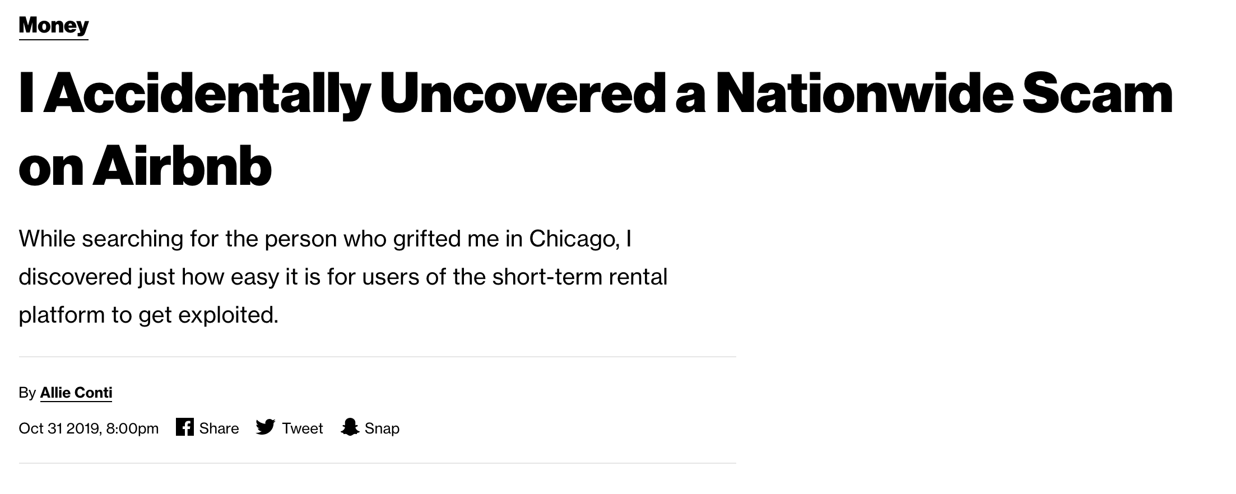
Project Motivation

Slide 3
Datasets
NY December 2019 Listings Dataset
200 + columns
40372 rows (listings)
NY December 2019 Reviews Dataset
6 columns
1000,000+ rows (comments)
NY January Listings Dataset
200 + columns
40000+ rows (listings)
NY January Comments Dataset
6 columns
100000+ rows (comments)
Extracted from:
http://insideairbnb.com/get-the-data.html
NO TARGET COLUMN!!!!

Slide 4
Quick Focus Change
No initial indication of what is a scam listing
How do you quantify a scam listing?
Compare listings in January vs December
Missing listings are indicative of
Owner Removal
Non-AIRBNB compliant (suspicious)
25000+ listings ”removed”
347142 comments to work with
Renamed “Removed-dataset”

Slide 5
PROCESS WORK-FLOW
Tokenize/Lemmatize
Topic modeling (Grouping similar words)
K-means
Agglomerative clustering
Latent Dirichlet allocation (LDA)
Sentiment analysis
Differentiate +ve/-ve comments
Group comments into topics and sentiment
Comments
Tokenize
Clustering
Sentiment
Outcome

Slide 6
Why LDA model
Classify text/sentence in a document to a particular topic
Builds topic per document
Words per topic model based on their probabilities to be in each topic
No words exclusive to just one topic
Retains meaning

Slide 7
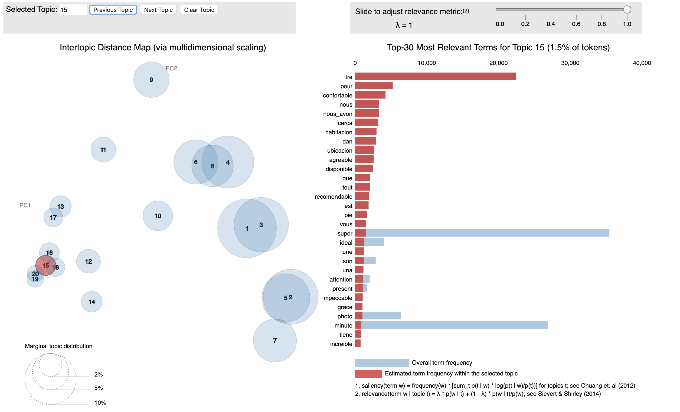
LDA MODEL ON “REMOVED” DATASET
Inputs
Dictionary( comments)
Corpus (lemmatized words in dictionary
No of topics needed: 20
No of cores used : n-1
Outputs
20 topics
Perplexity score: -8.7
Coherence score: 0.49

Slide 8
2nd LDA MODEL ON “REMOVED” DATASET (Updated)
Translated non-english words
Decide on number of topics we want (5)
Aparment facilities
Host Experience
Location
Host Communication
Overall Experience
Outputs
5 distinct topics
Coherence score: 0.55
Hypertuning
Parameters changed
Alpha [0.1-1,symmetric,assymetric]
Beta [0,1]
Best model : alpha=1, beta=0
Coherence score: 0.61

Slide 9
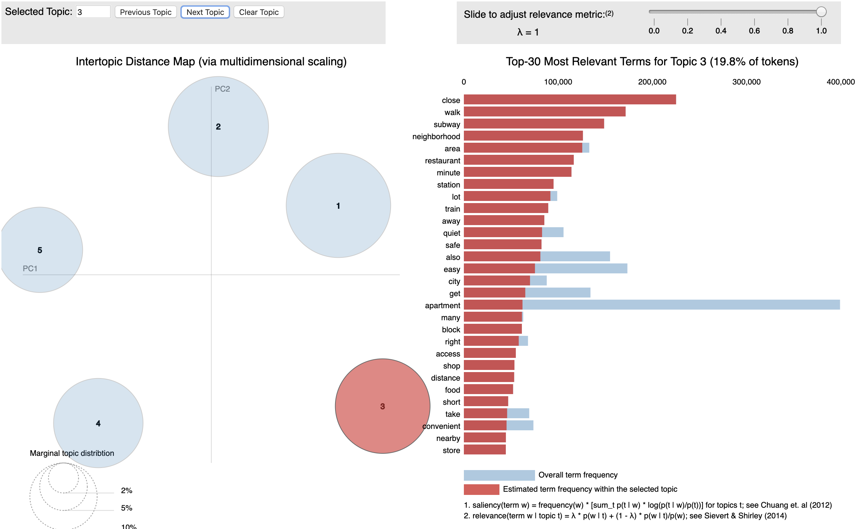
LDA MODEL ON December Dataset
Outputs
5 distinct topics
Coherence score: 0.60
Not much different from test
Model generalizes well

Slide 10
Using VADER for sentiment analysis
VADER (Valence Aware Dictionary and sEntiment Reasoner) is a lexicon and rule-based sentiment analysis tool that is specifically attuned to sentiments expressed in social media/reviews
It doesn’t require any training data but is constructed from a generalizable, valence-based, human-curated gold standard sentiment lexicon
Scored from a range to -1 to 1
-1 being overall negative
+1 being overall positive

Slide 11
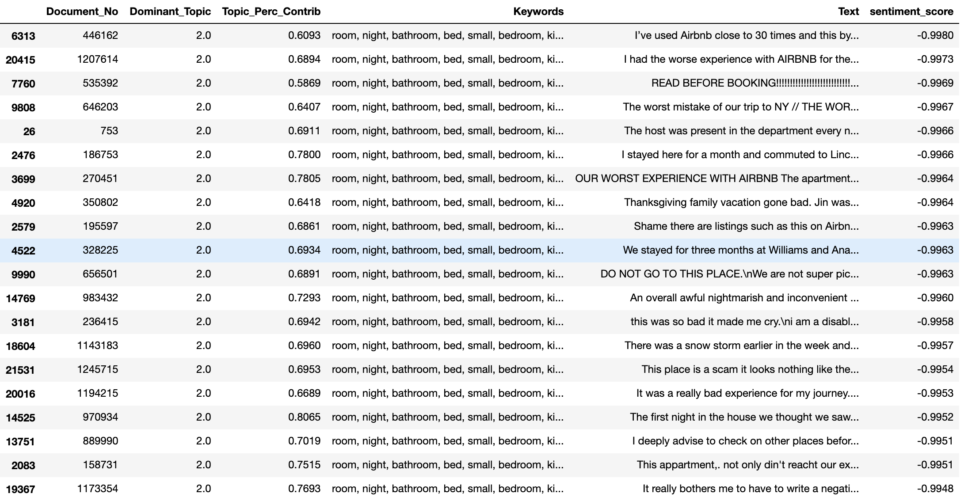

Slide 12
Making an Informed Decision
We have comments grouped based on
5 topics
Sentiment
What topics are most likely scam related
Host Experience
Host Communication
Overall Experience
Filter ”scam” listings out
AIRBNB to validate further
Users wont “accidentally” pick listing

Slide 13
Potential Impacts
10276 out of 40372 listings deemed suspicious
25% less likely a person will book a suspicious listing
More positive experience for AIRBNB users

Slide 14
THANK YOU

Slide 15
GOAL
Listings
Predict
AIRBNB
Scam/Legit
AIRBNB USER
Validate Predictions
Filter out ‘SCAM’ Listings
Cluster
+
Recommend
Further verify listings

